Slide 1
Rise in crime and its relation with the education system

Slide 2
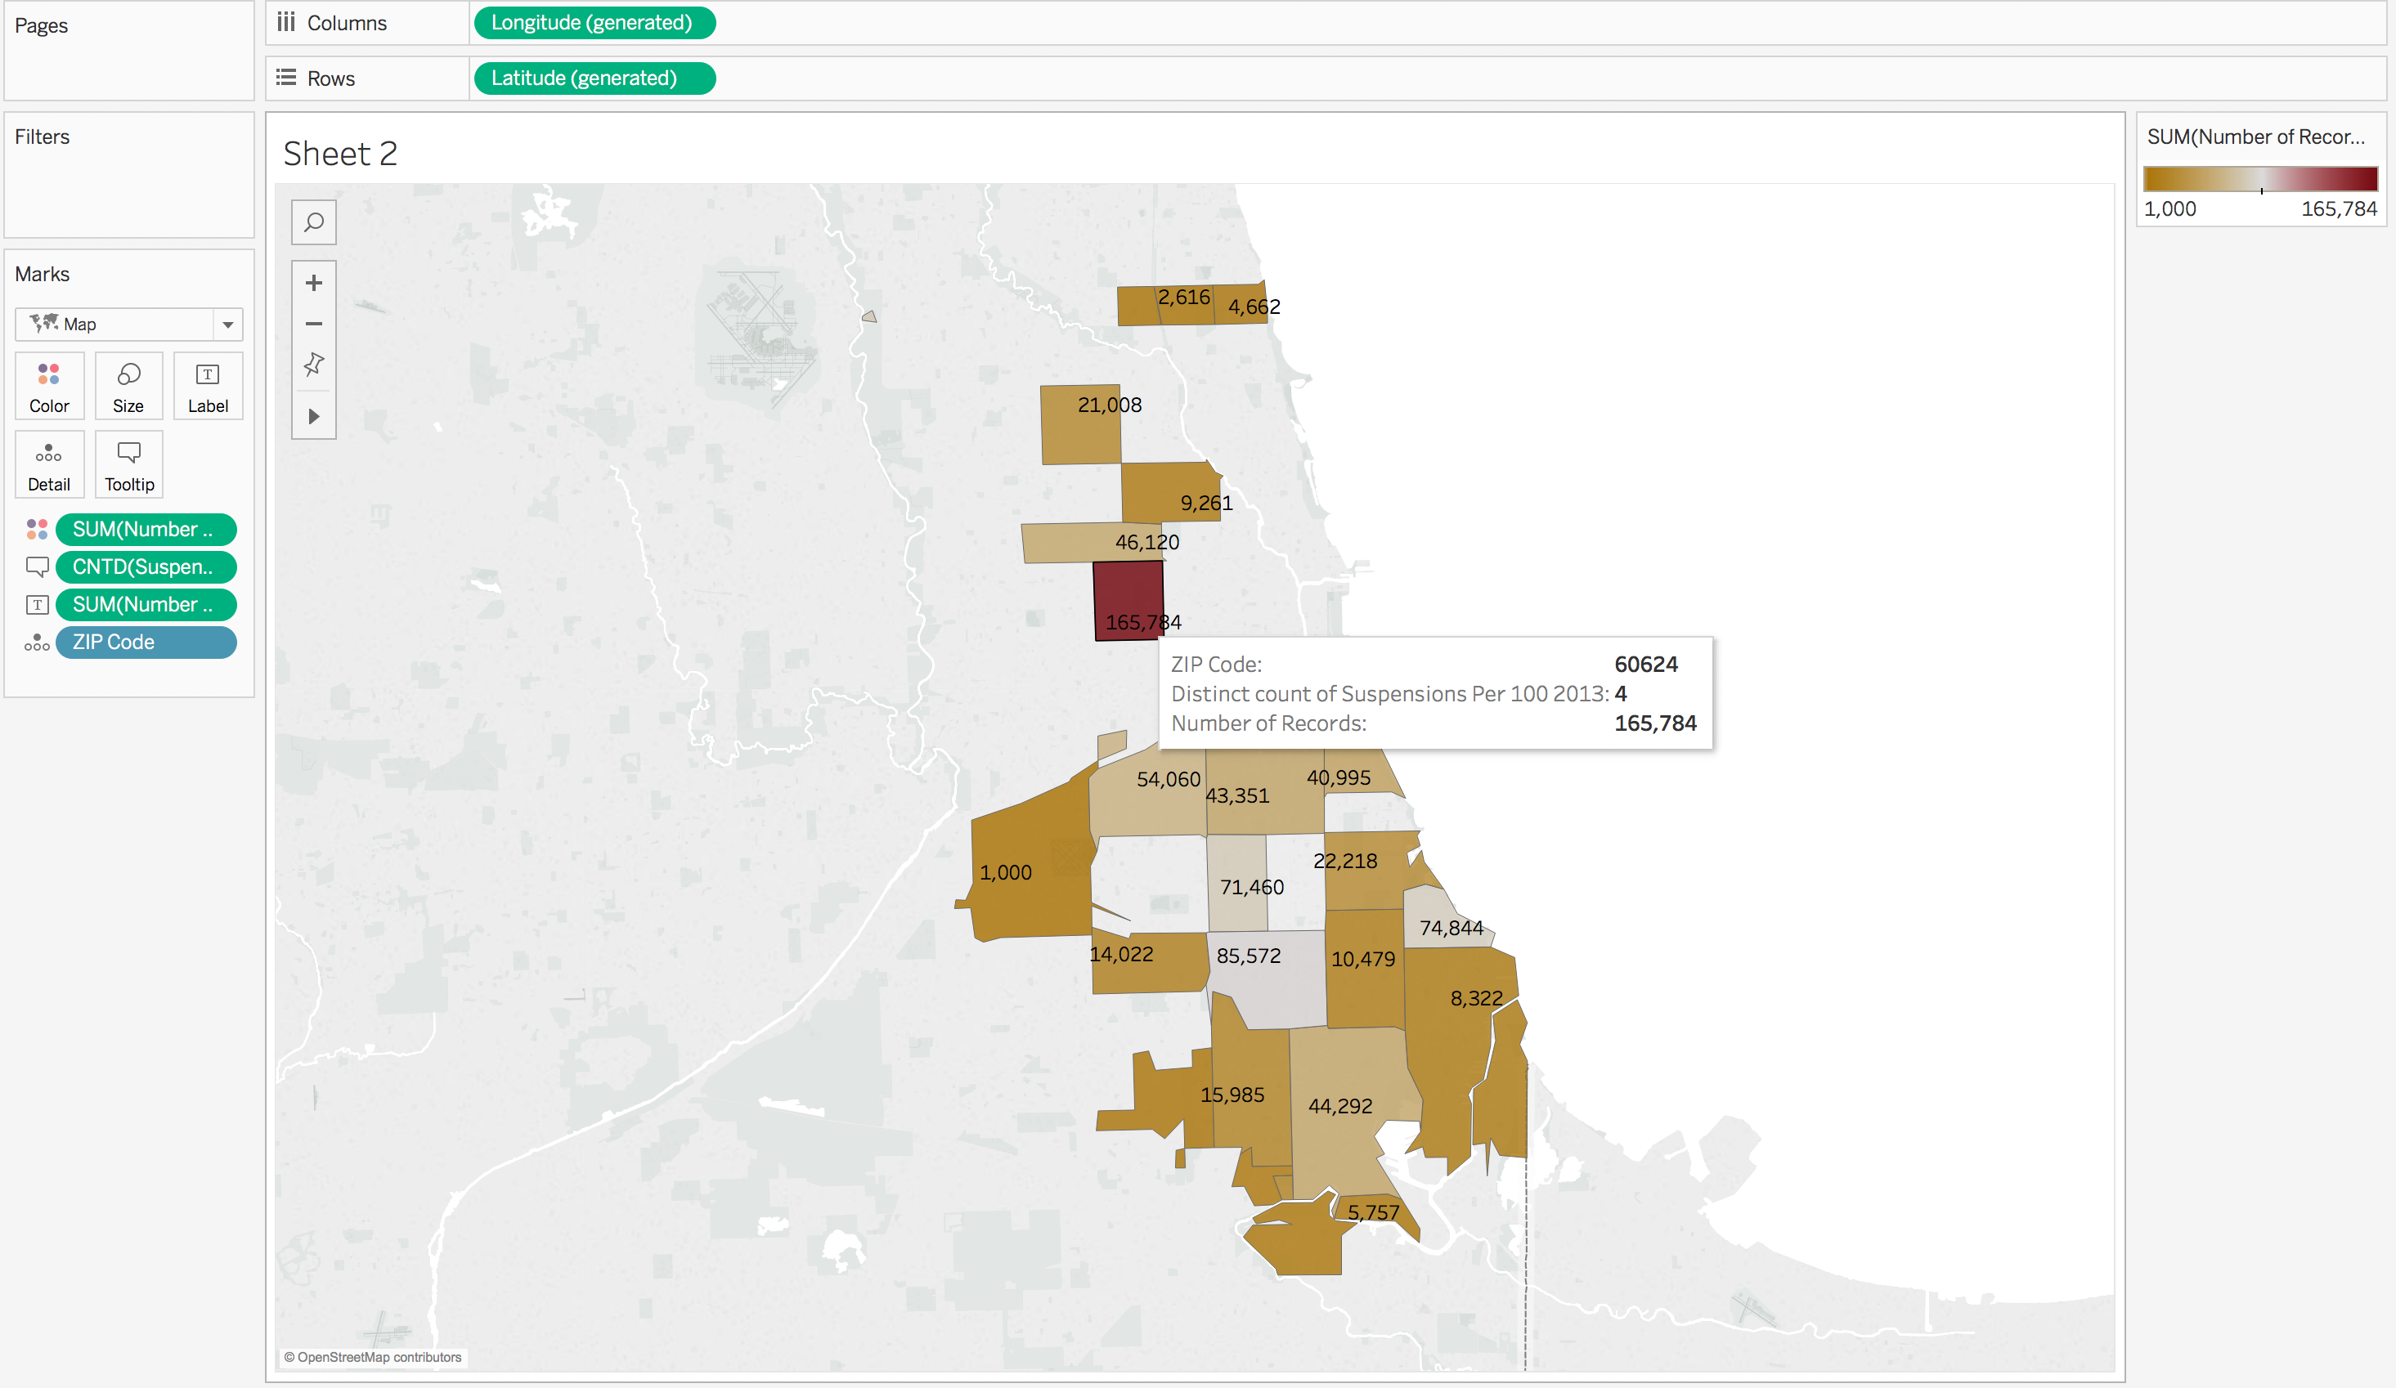

Slide 3
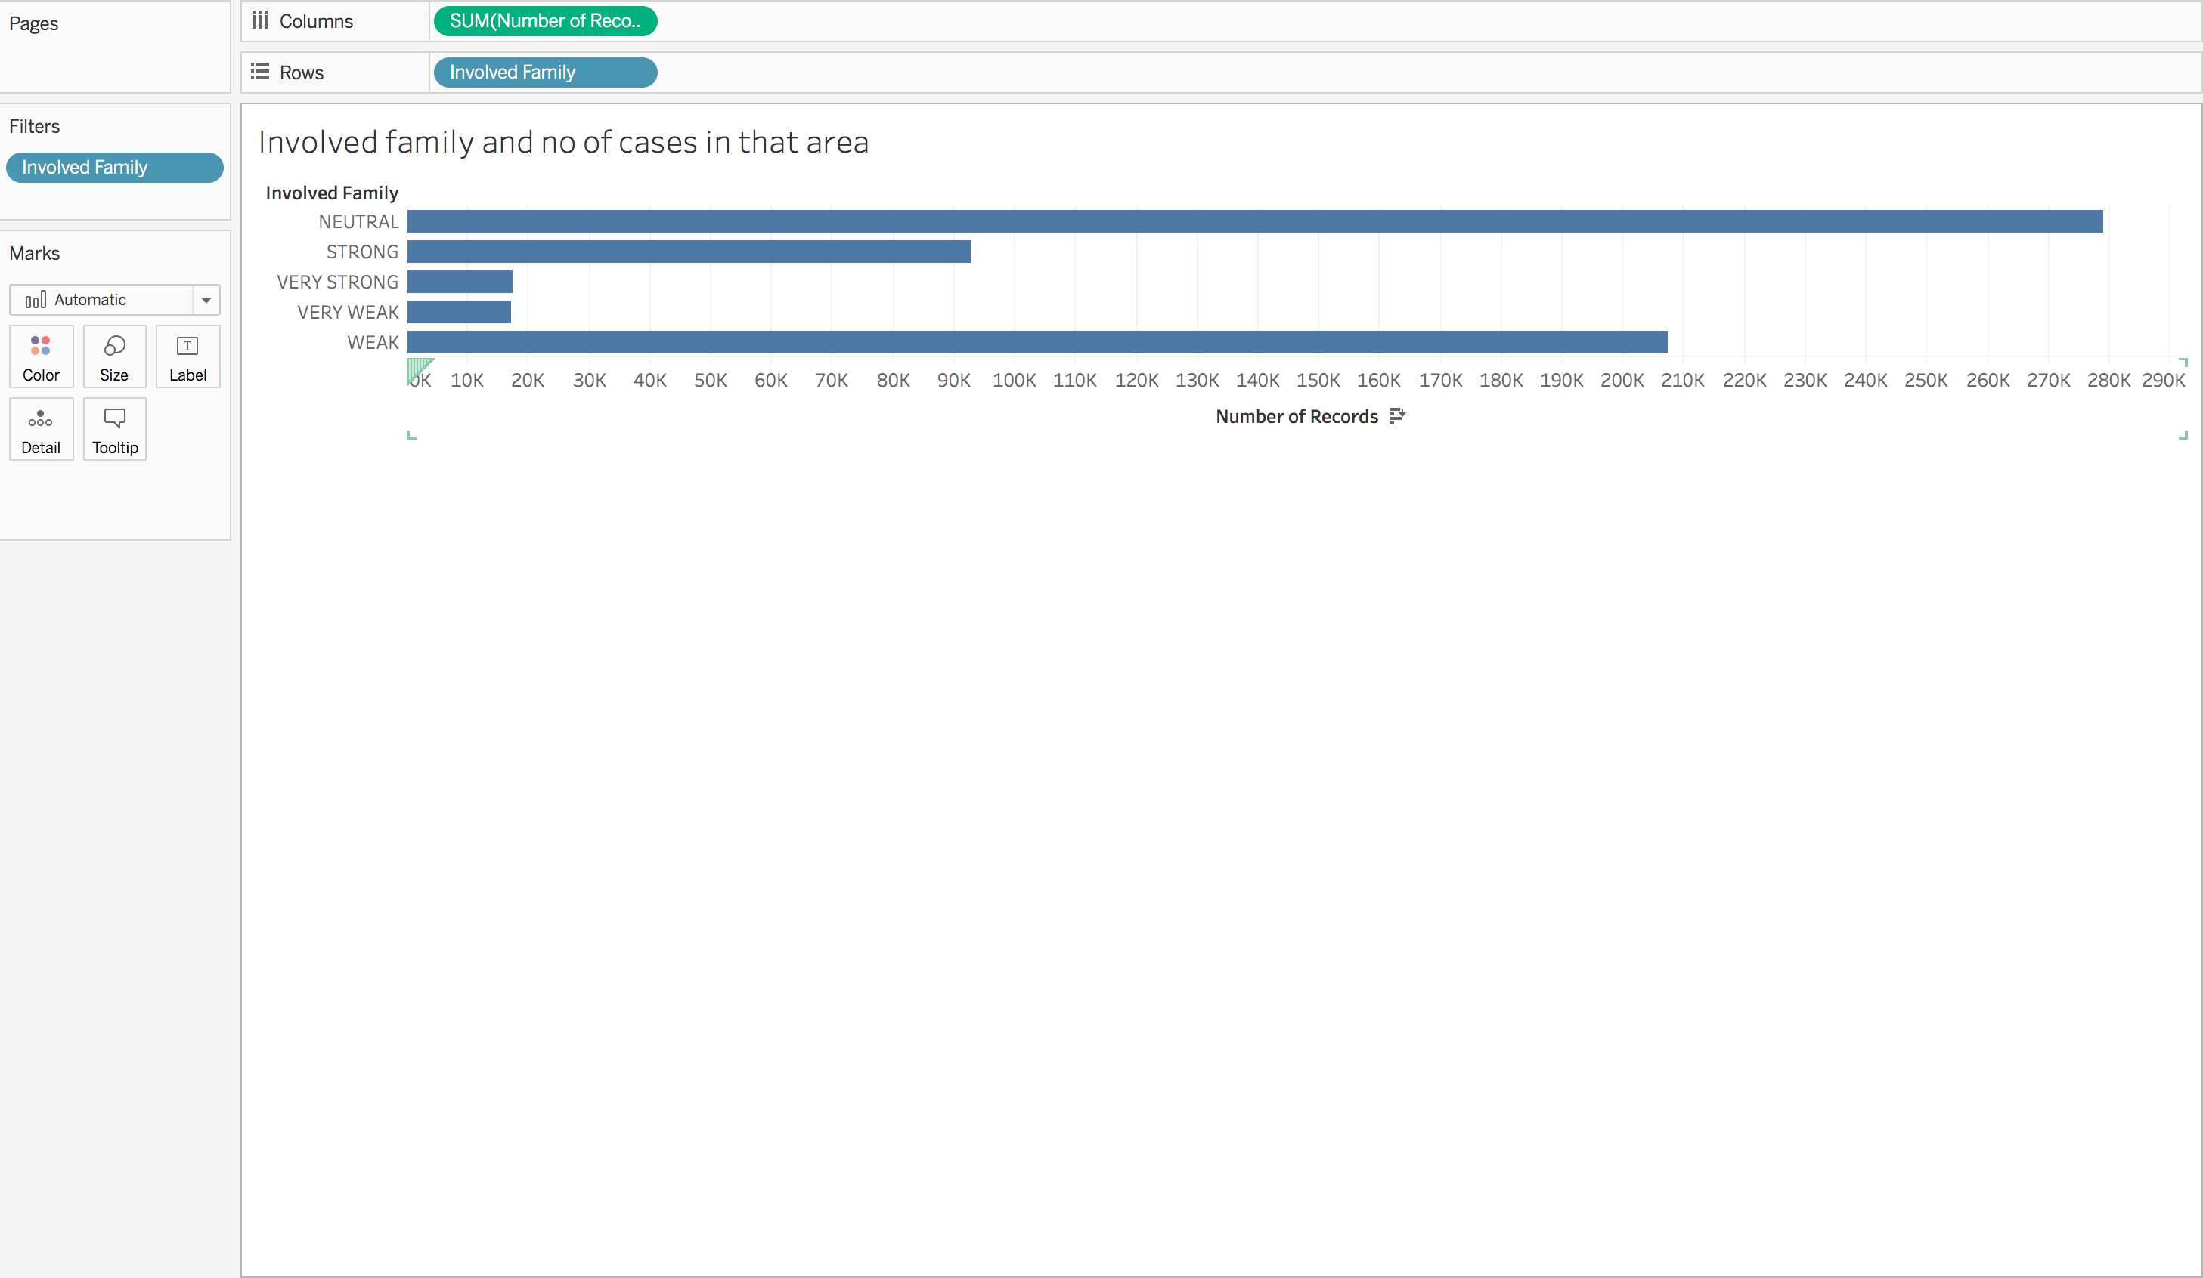

Slide 4
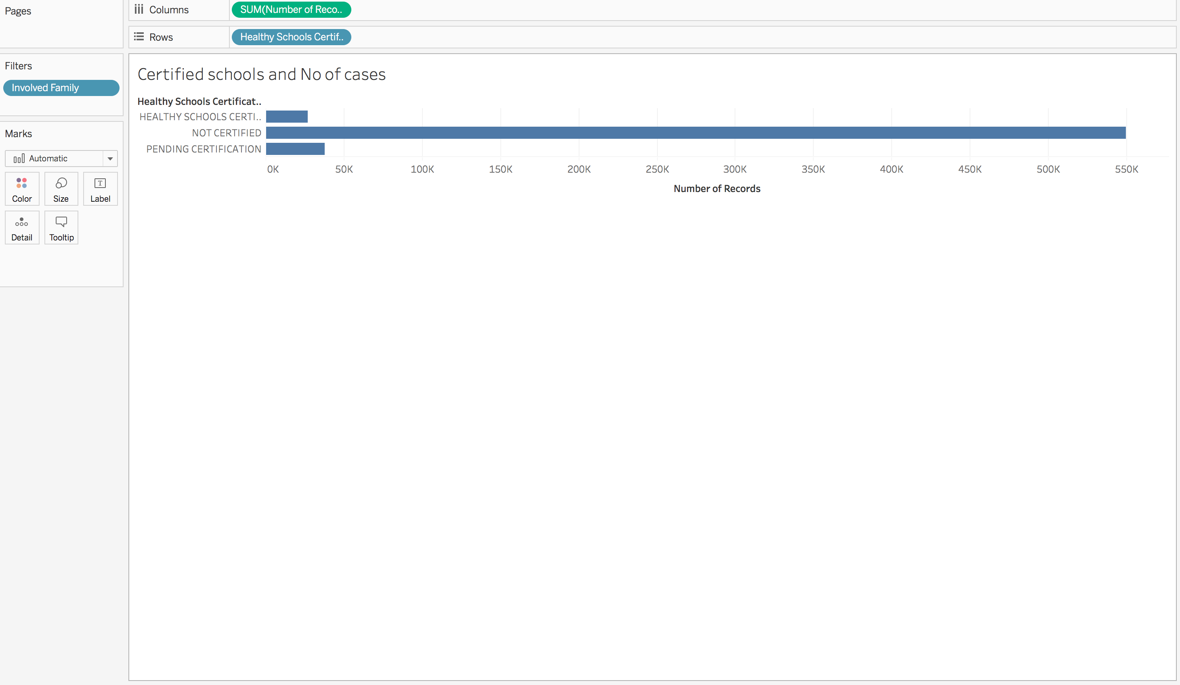

Slide 5
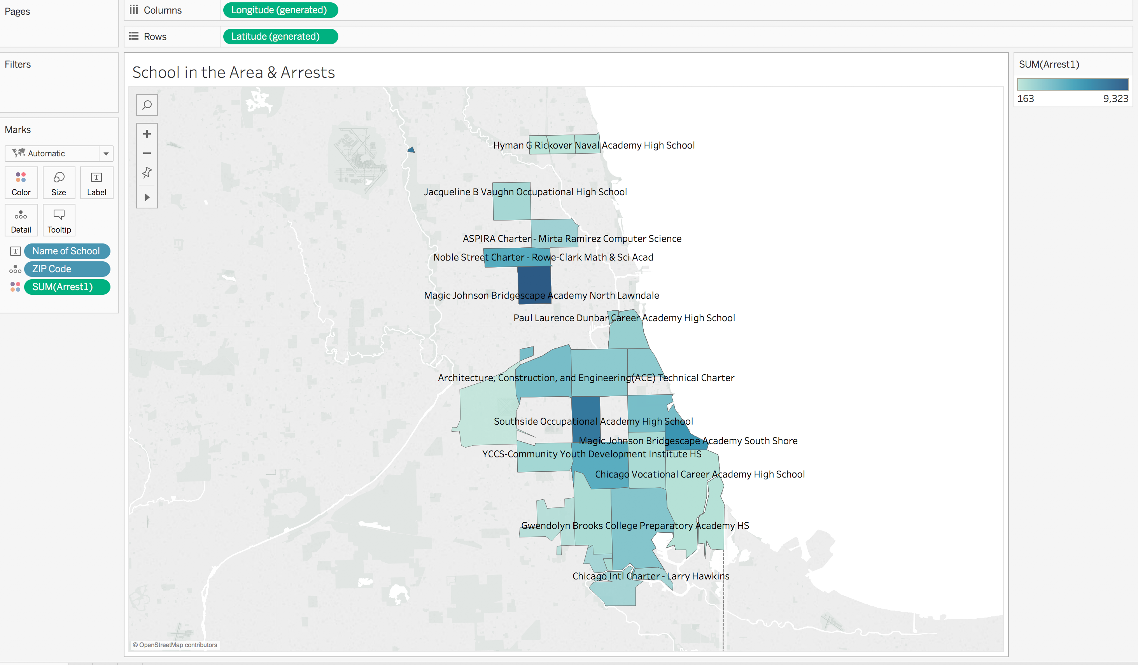

Slide 6
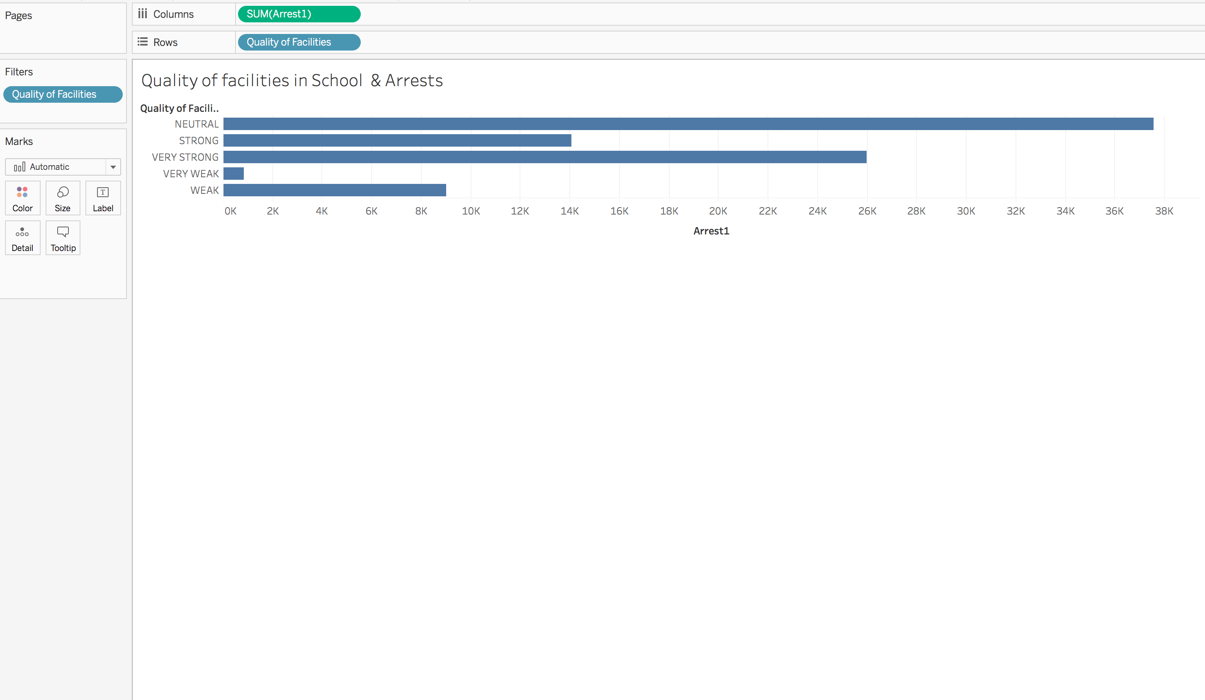

Slide 7
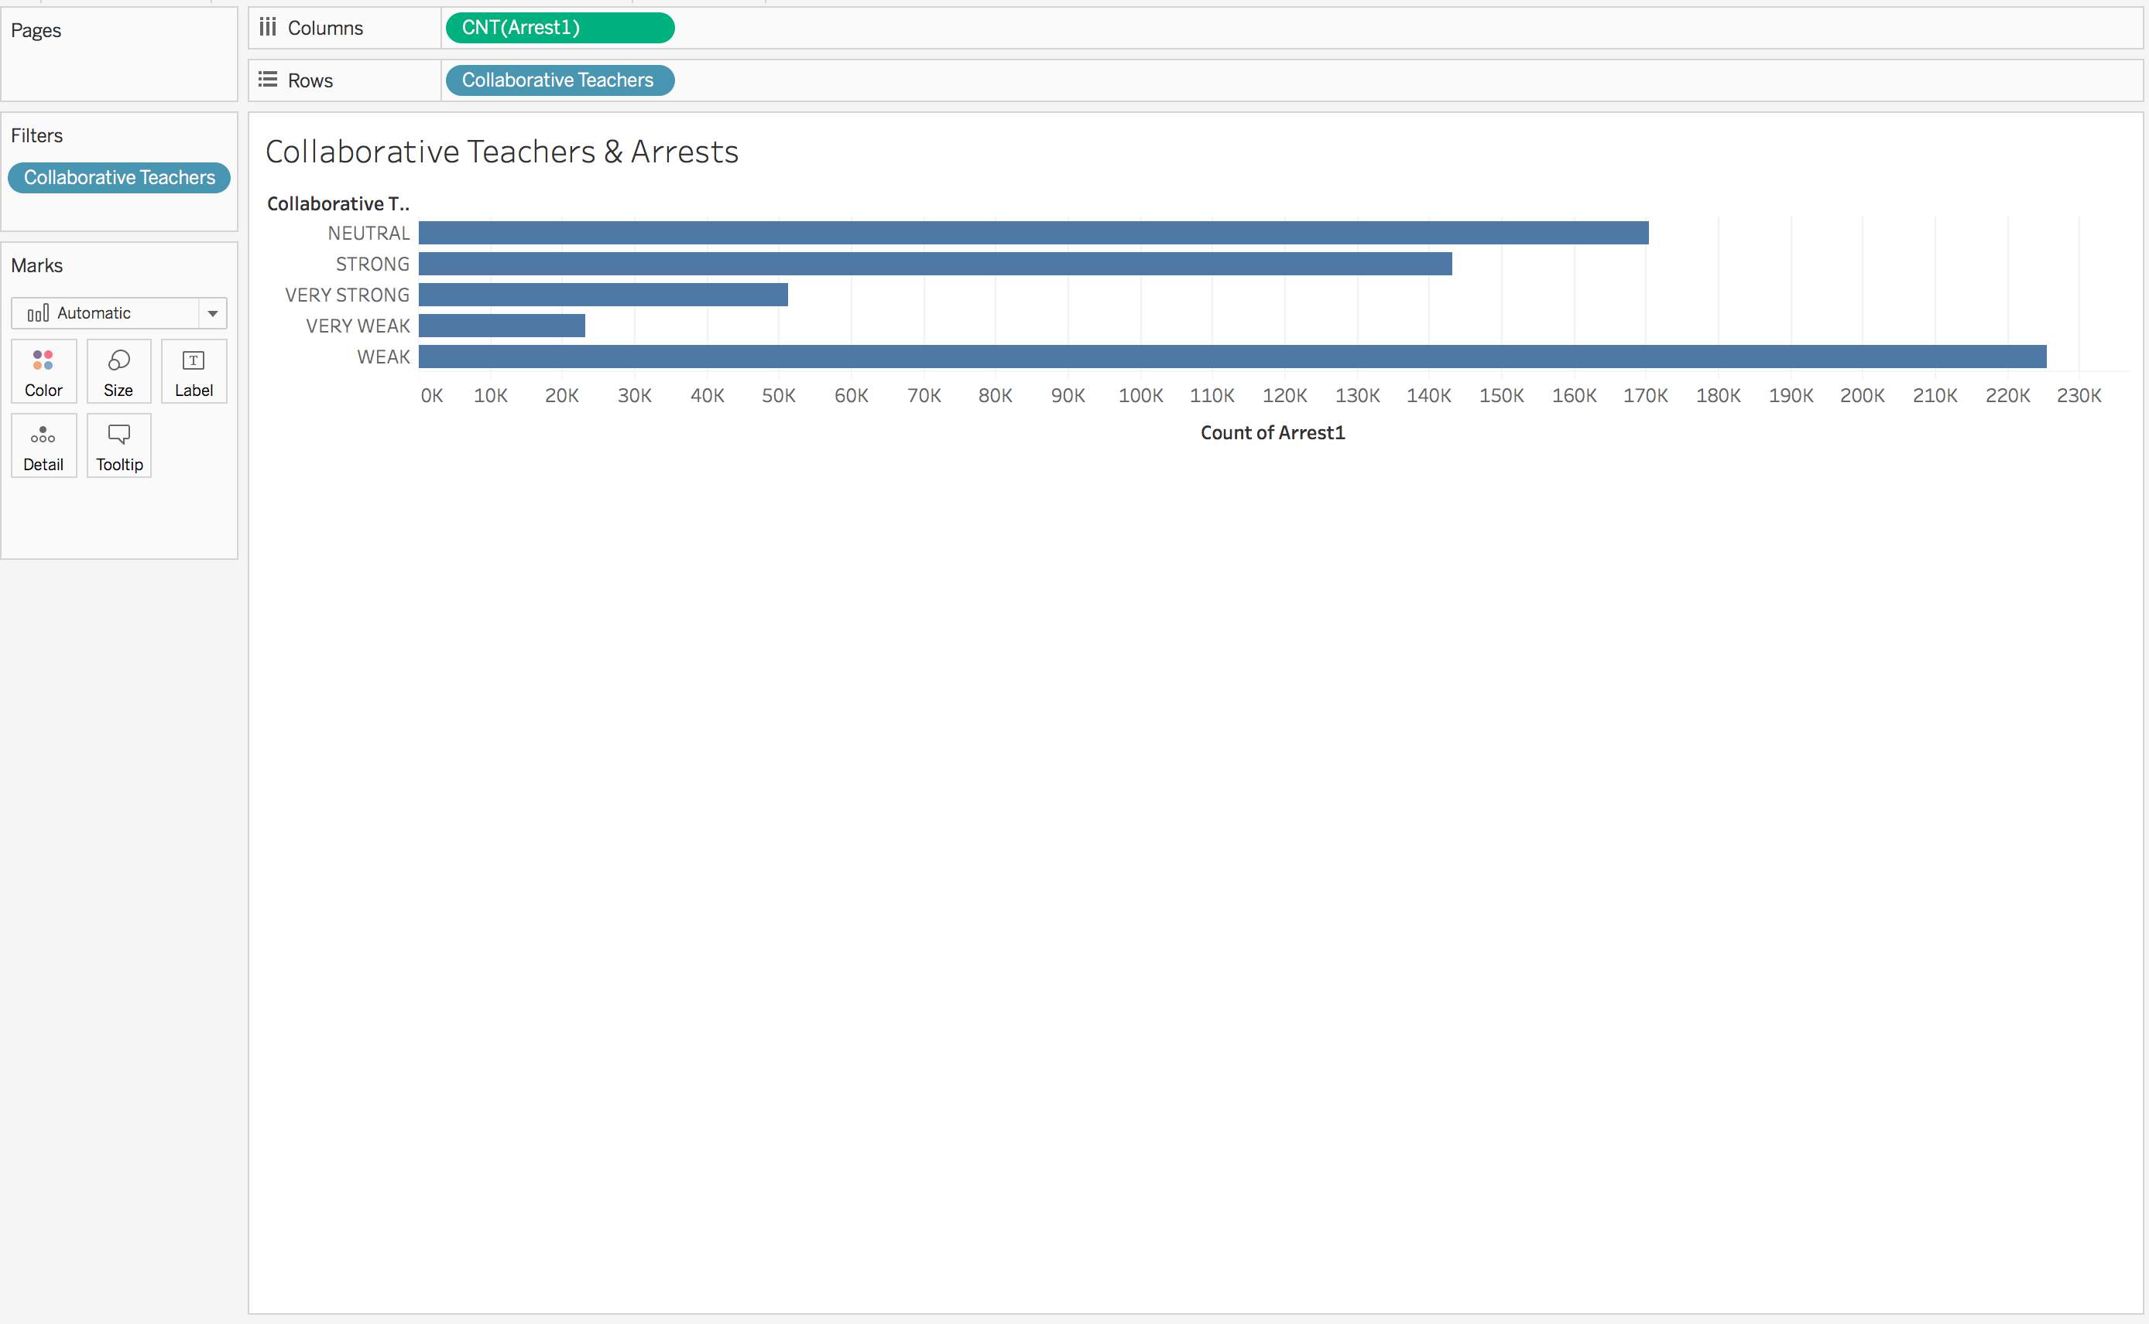

Slide 8
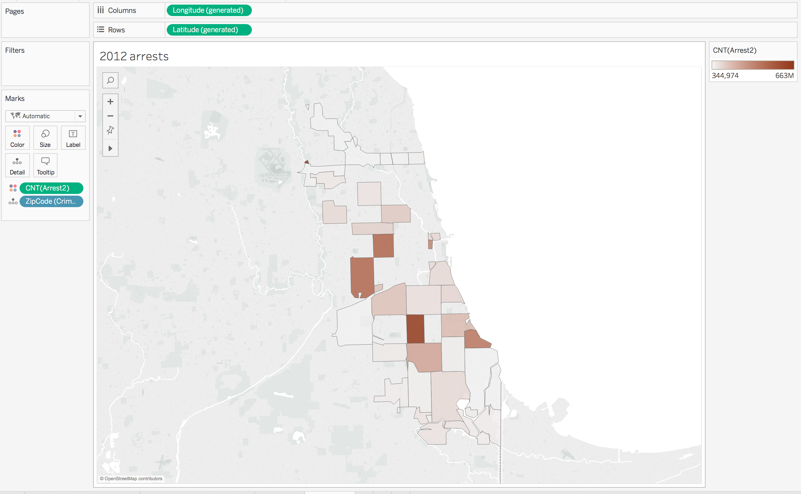
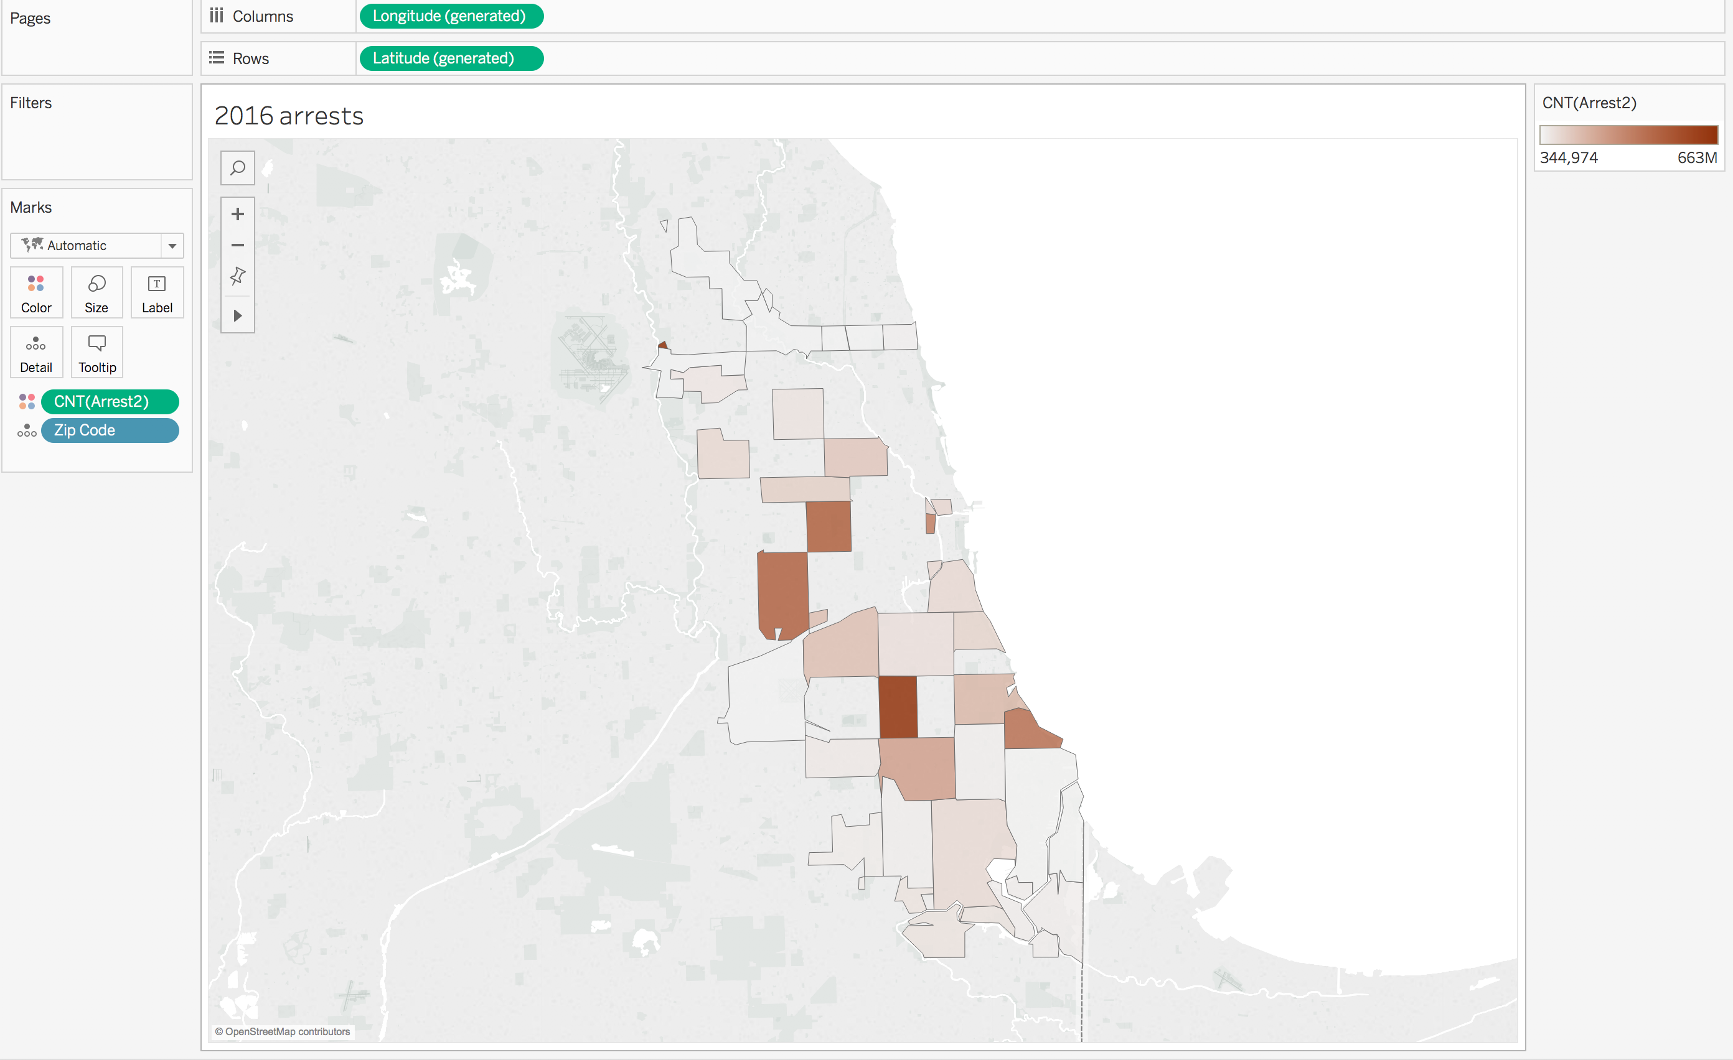
Significant increase in arrests between 2012 and 2016

Slide 9
Poor Quality of school facilities leads to increase in crime.
01
Non Collaborative teachers leads to increase in crime.
02
Weak and neutral families leads to increase in crime.
03
Non Certified school area has higher crime rate.
04

Slide 10
Thank You

